Slide 1



Comprehensive Analysis of Book Trends
Anu Chandrasekar

Slide 2

Introduction :Unveiling Trends in the Literary World (2009-2019)
A comprehensive analysis of book trends from 2009 to 2019,
Focusing on genre popularity
Top-reviewed novels
Sales performance
Dominance of fiction versus non-fiction genres
With non-fiction leading at 56.36% of the market share compared to fiction’s 43.64%, this dashboard uncovers the preferences of readers, the impact of critical acclaim, and the commercial success of different genres.
Join me as we dive into these insights to understand what shaped the book industry over this decade.

Slide 3
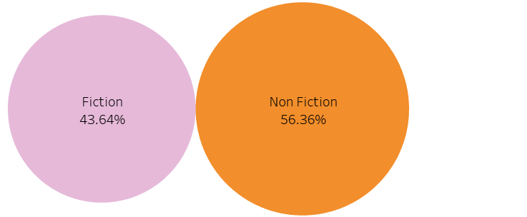




Most Popular Genre (Fiction vs. Non-Fiction)
The Bubble chart illustrates the distribution of book popularity between fiction and non-fiction genres, based on a dataset spanning 2009 to 2019 . The data is presented as percentages, with non-fiction leading slightly over fiction.

Slide 4
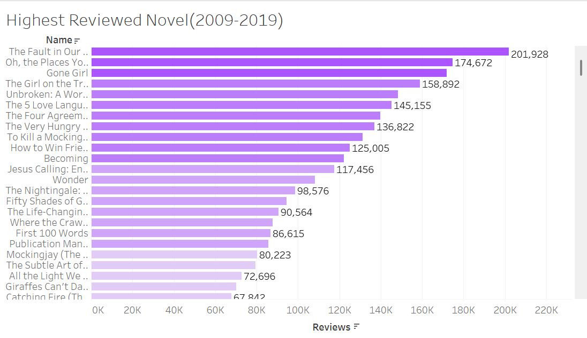
Highest Reviewed Novel
This horizontal bar chart displays the most reviewed novels from 2009 to 2019, ranked by the number of reader reviews.
Key Findings :
"The Fault in Our Stars" tops the list with 201,928 reviews, making it the most reviewed novel in the given timeframe.

Slide 5
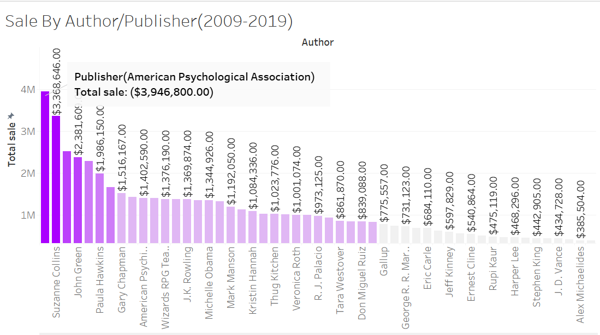
Sales by Author / Publisher
The American Psychological Association(APA) is a major publisher in the field of psychology, known for its scholarly and professional books, including the Publication Manual of the American Psychological Association, a widely used style guide.
The APA also operates imprints like Margination Press (children’s books) and APA Life Tools, and it publishes a range of academic books, journals, and digital resources.
American Psychological Association(APA) made a total revenue of $ 4 Million and was the leader in sales

Slide 6
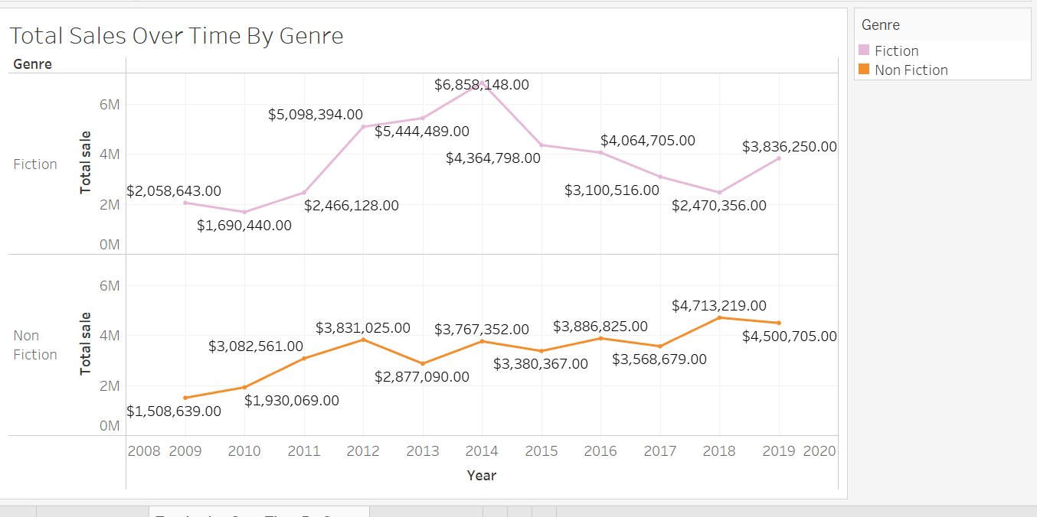
Total Sales : Fiction vs Non-Fiction
Line Chart to show sales trend over time
Fiction sales : Fiction sales started at $1,690,440 in 2009, peaked at $6,858,148 in 2014, and then declined to $3,836,250 by 2019.
Non-Fiction Sales : Non-fiction sales began at $1,508,639 in 2009, steadily increased to $4,713,219 in 2016, and reached $4,500,705 by 2019

Slide 7
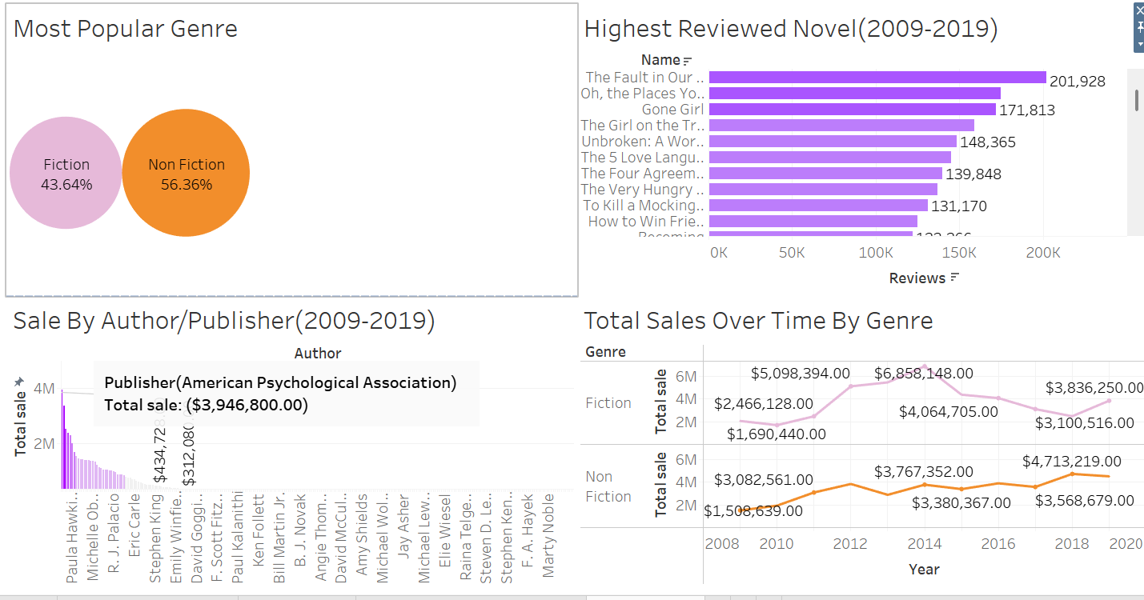
Book Sales BI Dashboard

Slide 8
Findings & Insights
Cultural Trends: The preference for non-fiction could reflect a growing interest in self-improvement, education, or real-world knowledge during the 2009-2019 period.
Market Dynamics: Non-fiction often appeals to a broader audience, including professionals, students, and lifelong learners, whereas fiction might cater more to specific tastes (e.g., romance, fantasy, or literary fiction). This broader appeal could explain non-fiction’s higher popularity.
Economic Factors: Non-fiction books, especially those tied to professional development or education, might have seen higher demand during this period, possibly due to economic recovery efforts post the 2008 financial crisis, where readers sought practical knowledge to improve their careers or lives.
Fiction dominated early years but saw fluctuations, while Non-Fiction showed steady growth and eventually surpassed Fiction in total sales towards the end of the period

Slide 9
Tools Used
Microsoft Excel for data cleaning and transforming the data to find meaningful insights
Tableau for data transformation and to create charts and graph for data visualization

